Slide 1
Power Inverter
Name:
School:
Professor:
Date:

Slide 2
Introduction
Power inverter is a circuitry that is used to change the direct current to alternating current.
Solar inverters/grid inverters convert the solar power to direct current electricity that is generated by the PV panels to alternating current
The maximum power output of the solar PV cell can be enhanced by the combination of the voltage or current. MPPT seeks to get the maximum power that is available from the cell in order to maximize yield. They maximize electricity yield through constant varying of the load (Palani & Harjani, 2017).

Slide 3
Different types of solar inverters
Micro-inverters
- Micro inverters serve the purpose of any other panel that contains the same features and operates in the same conditions by having an inverter installed at the back of every panel.
- In order for micro-inverters to work efficiently, they need MPPT, which works better compared to use of an antenna to which affects its efficiency.

Slide 4
Ingredients of power inverter
The power inverter works by converting direct Current (DC) of the power coming in and converts it to alternating current (AC). However, it is important to settle for the best power inverter according to use.
The following are requirements of a power inverter;
-Power inverter works in both automotive electronics and power semiconductors.
-Solar thermal collector
-Photovoltaic PV cell
-Concentrated solar power

Slide 5
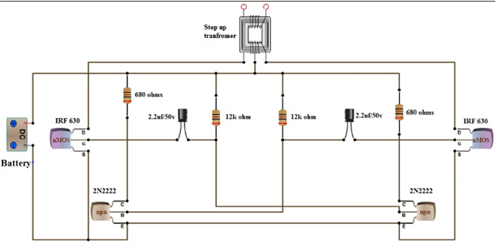
Circuit Diagram

Slide 6
Benefits of micro-inverters
Cost per watt for micro-inverters is reduced by simple installation
- It is easier to raise the system size and add panels
- It is reliable and in case of a single part of the system fail, the other still works
- It has increased lifetime approximately 25 years
- It has a cheaper installation cost which is easier to wire
- It has enhanced monitoring and performance
- It has high yields of the energy harvested

Slide 7
Drawbacks of micro-inverters
-Expensive
- Costly to replace
- Useful to situations that only have shading significance
- Relative lack of expertise once the system breaks down

Slide 8
The string inverters
-The string invertors only work efficiently when the solar PV panels attached have similar characteristics and they are working under the same conditions.
-It is therefore advisable to install a PV panel that operates under the same conditions (National Renewable Energy Laboratory (U.S.), United States., & United States, 2015).

Slide 9
Reference
Loncarski, J. (n.d.). Peak-to-Peak Output Current Ripple Analysis in Multiphase and Multilevel Inverters [recurso electrónico].
National Renewable Energy Laboratory (U.S.), United States., & United States. (2015). Inverter Load Rejection Over-Voltage Testing: SolarCity CRADA Task 1a Final Report. Washington, D.C: United States. Office of the Assistant Secretary of Energy Efficiency and Renewable Energy.
Palani, R. K., & Harjani, R. (2017). Inverter-Based Circuit Design Techniques for Low Supply Voltages. Cham: Springer.

